Slide 1
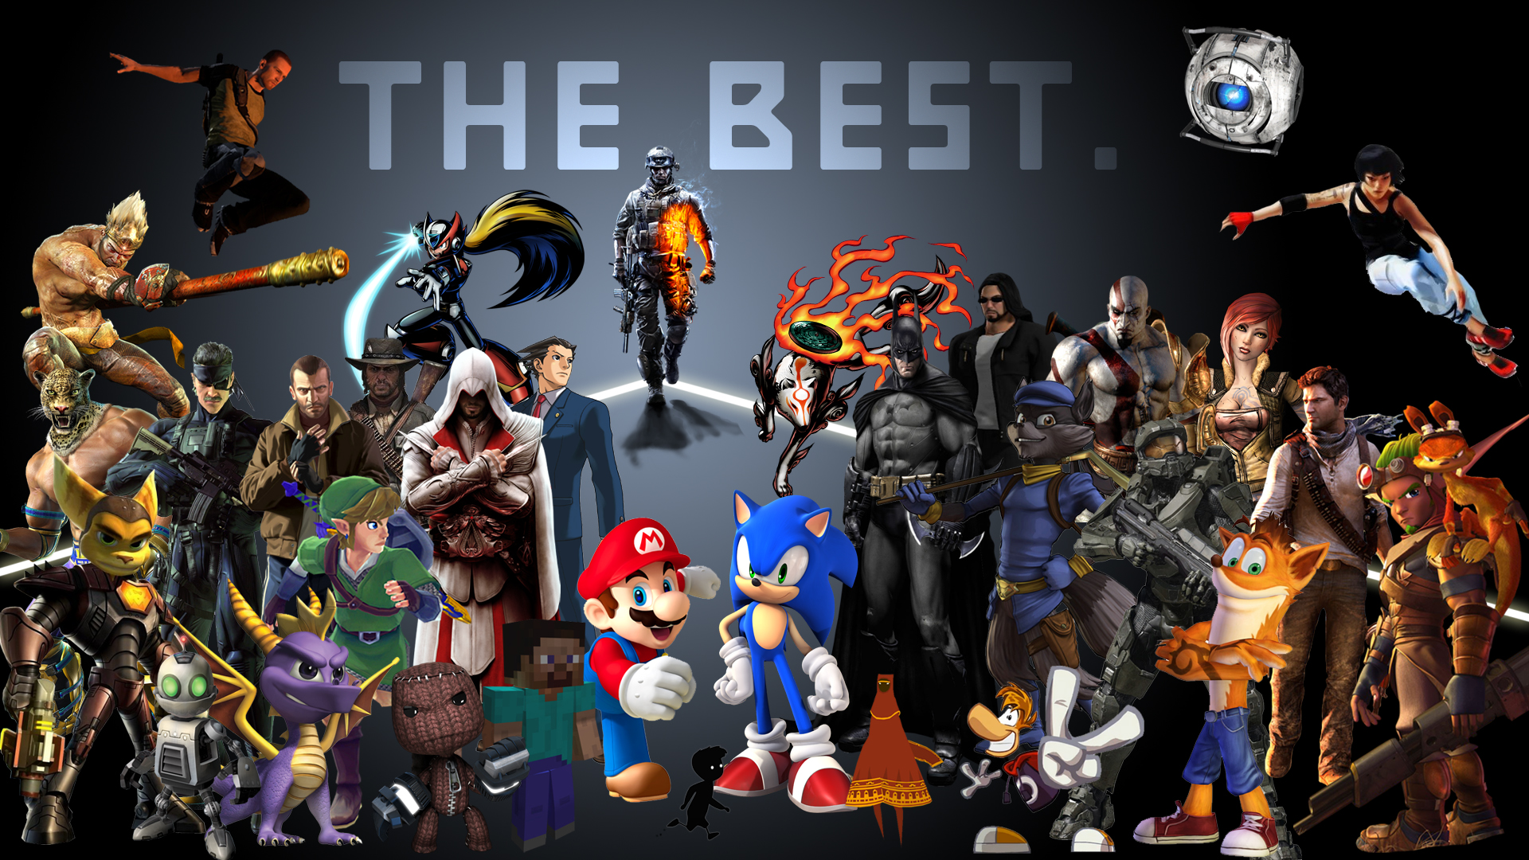
Video Game Recommendation Tool
Using Google Colab, Machine Learning, Flask API, SQL, HTML/CSS, JavaScript, & Python Pandas
Alvaro, Dozie, Emmanuel, Erick, Jonathan, & Mickey

Slide 2
Goal 01.
Goal 03.
Build on existing infrastructure & past successes. Create a one-stop-shop for entertainment solution
Create a tool that is personable, relatable, scalable, & capable
Goal 02.
Goal 04.
Position Group 1 as sought after consultants & subject-matter experts in the video game industry, for both B2C and B2B
Leverage data analytics & data science to create actionable insights

Slide 3




Our Process
Selecting the “Idea”
Writing the Code
Crafting User Experience
HTML Implementation
Predict Sales & Scores
Pivot to new ideas to suit our data set
Select best idea that works before writing code
Review project requirements
Learn new libraries and packages such as NLTK and Scikit-Learn
Identifying limitations
Drop-down vs. user-input
Error message experiences
Designing look & feel
Mock ups
Branding
Integration with existing infrastructure
Building form fields
Connecting Python & HTML
Writing functions

Slide 4
Preview of Recommendation Tool
Specific Games
01
Developers/Publishers
Get recommendations based on your favorite game
Get recommendations based on your favorite Developers & Publishers
04
02
Search Options
03
Year/Rating
Sentences/Prompts
Get recommendations based on the year or rating
Get recommendations based on search queries or prompts

Slide 5




How it works
Text-based queries
Cross-referencing 4,000+ games
Enter a query into our website
The model takes that game and runs it through a similarity algorithm and assigns each game in the database a numerical value or “score”
User Input
Similarity Ranking
Best Match
Recommendation Engine
Identifying the best match
Top recommendations
Our model tries to find the one game that is most similar to your input
The games with the highest scores are presented as your personal recommendations

Slide 6


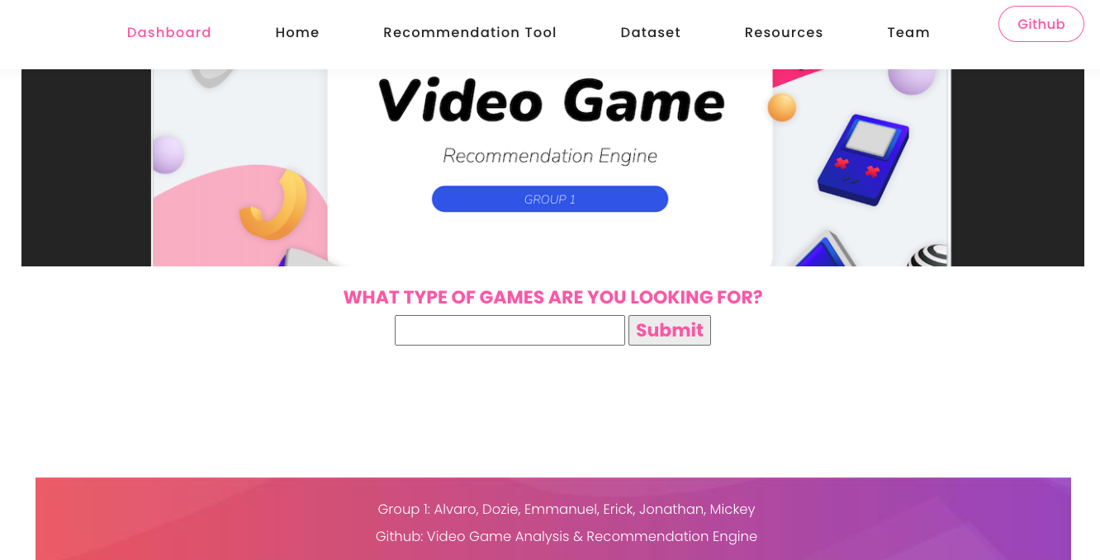
Live Demo
Video Game Recommendation Engine

Slide 7
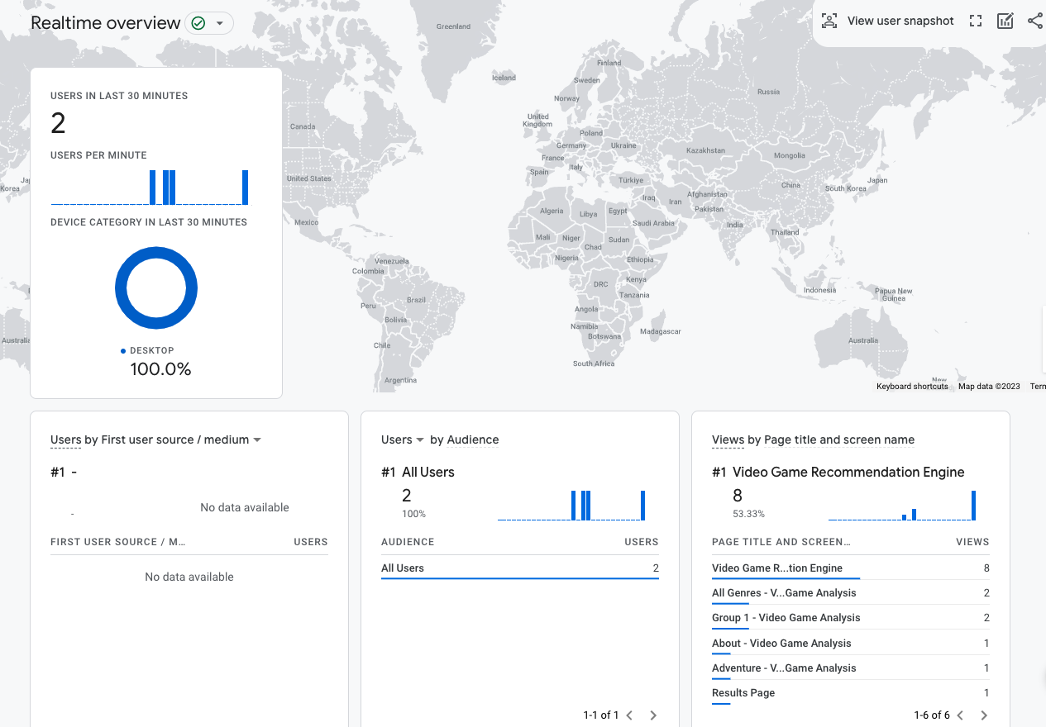
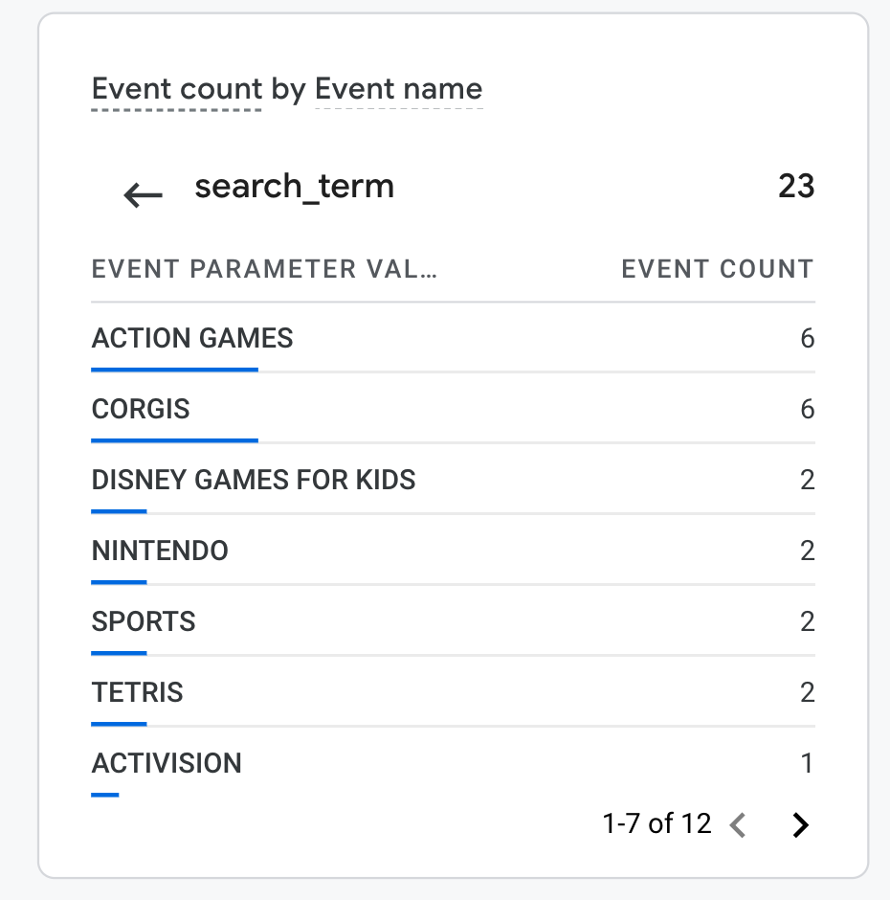
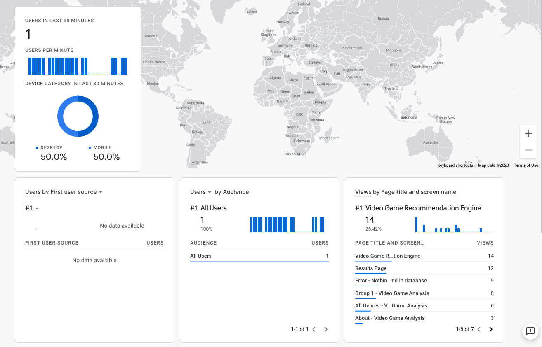
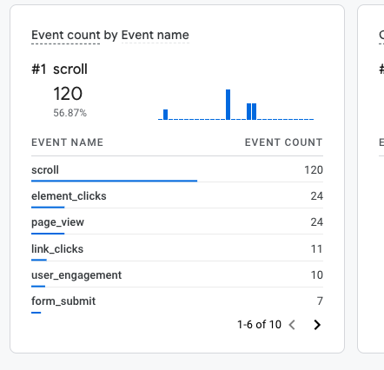
GOOGLE ANALYTICS || PREVIEW

Slide 8
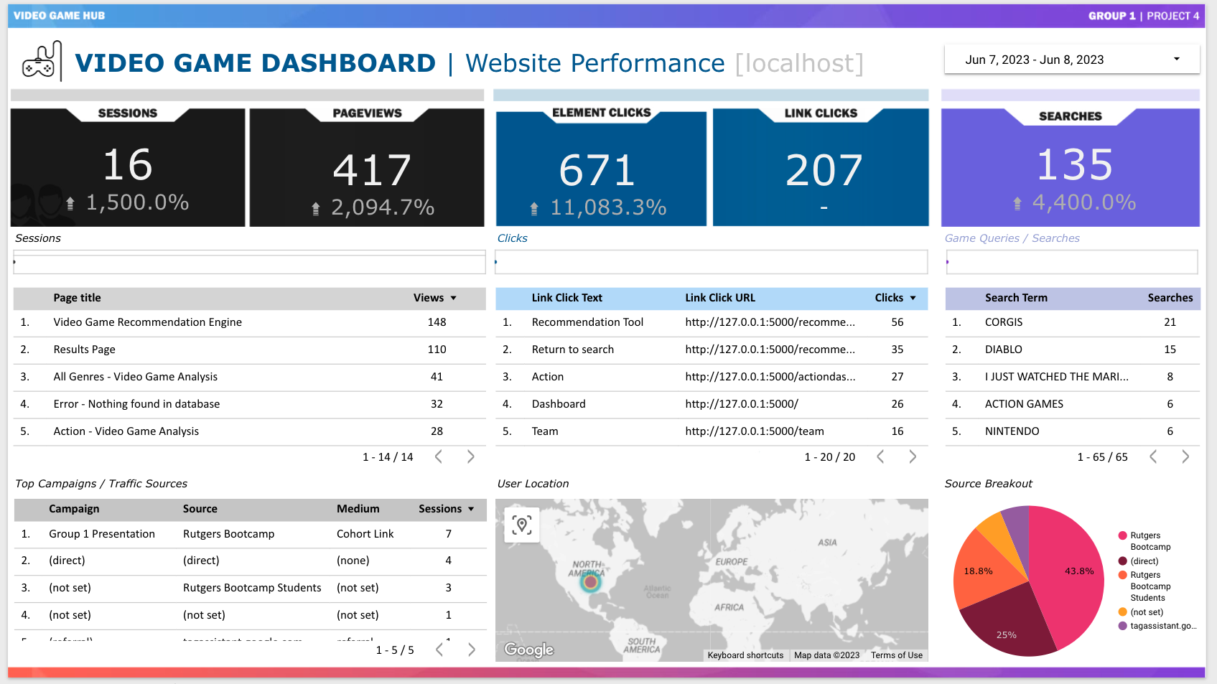

Slide 9


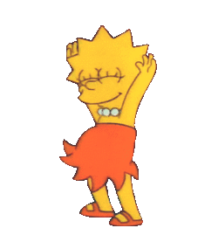
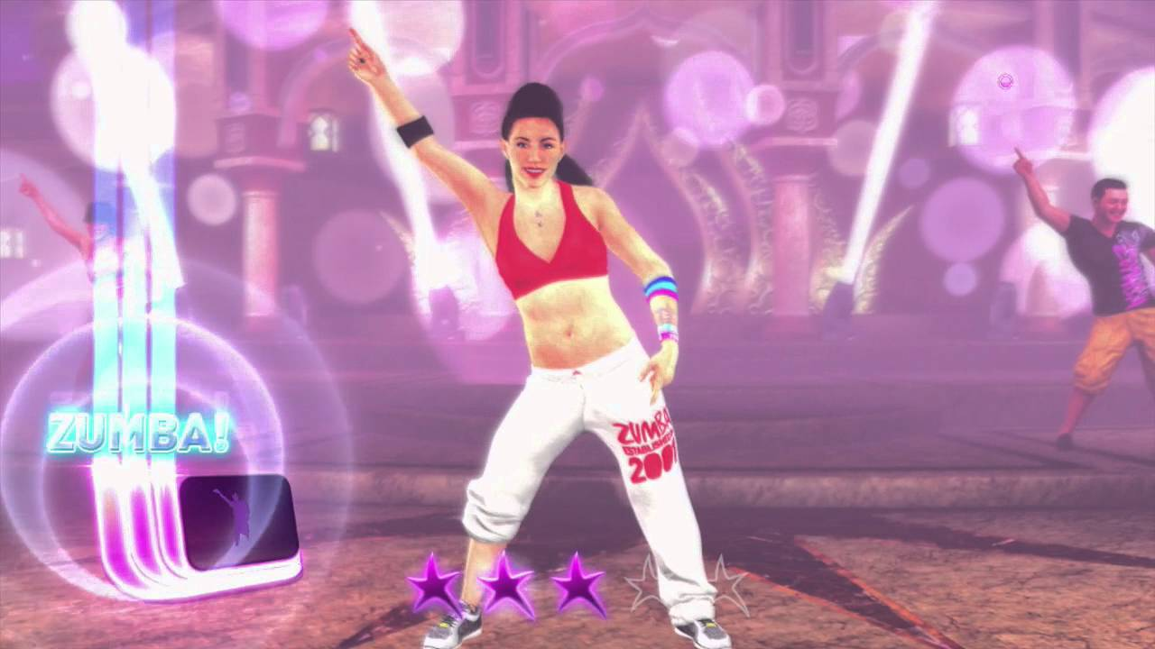
Recommendation Tool Findings
We Like the Recommendations
The Dreaded “Zumba” Effect
Room for Adjustments
Suits different preferences
Seems accurate across a wide breadth of queries
We found it hard to disagree with the recommendations
No results occurs too often, ultimately recommending the Zumba Fitness Rush & similar games
Issue fixed, but highlights limitations of dataset
Showing older iterations of the same game (i.e. Madden 09)
Dataset doesn’t have some of the most popular games
images via Clipart, Gyfcat Library, & YouTube

Slide 10


Project Limitations & Future Enhancements
Predictive Modeling Ain’t Easy
Limited Dataset
Enhance the User Experience
Optimize Coding Approaches
Developed multiple models with low accuracy/R2 scores
Find new datasets that better fit our models
Incorporate web analytics into models
Only up to 2016
Missing many games
No platform/consoles
A simple model due to lack of features
Include video game cover images, links to info/purchase
Create more personalized recommendations
Mobile friendly, voice search
Adjust HTML & CSS
Condense Flask & SQL queries
Enhance Google Analytics
Search is still buggy

Slide 11
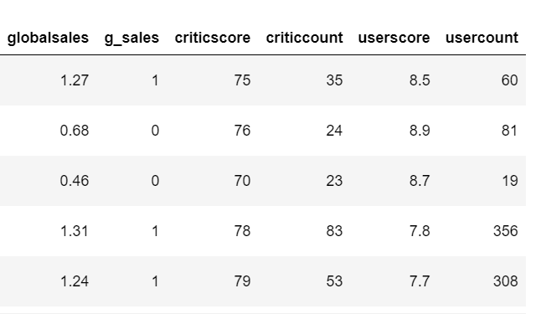
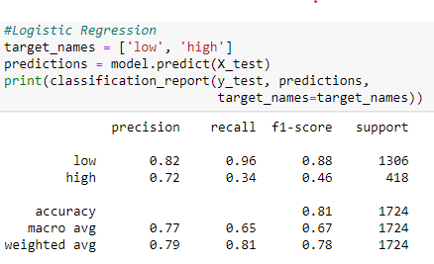
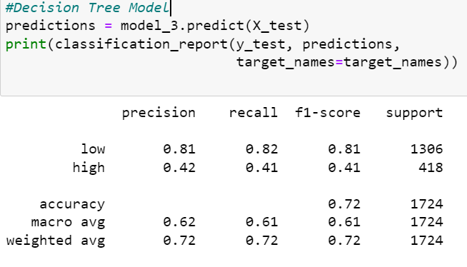
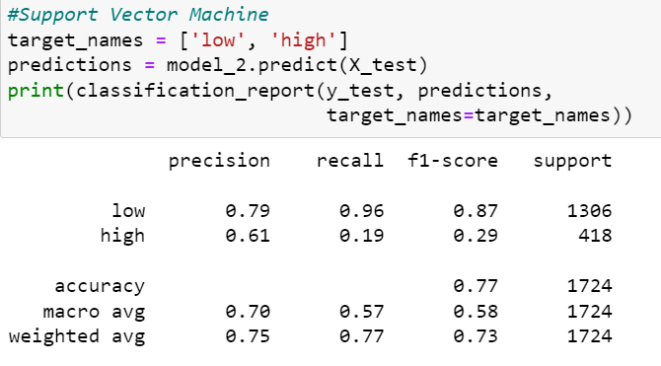
ML Classification Models

Slide 12
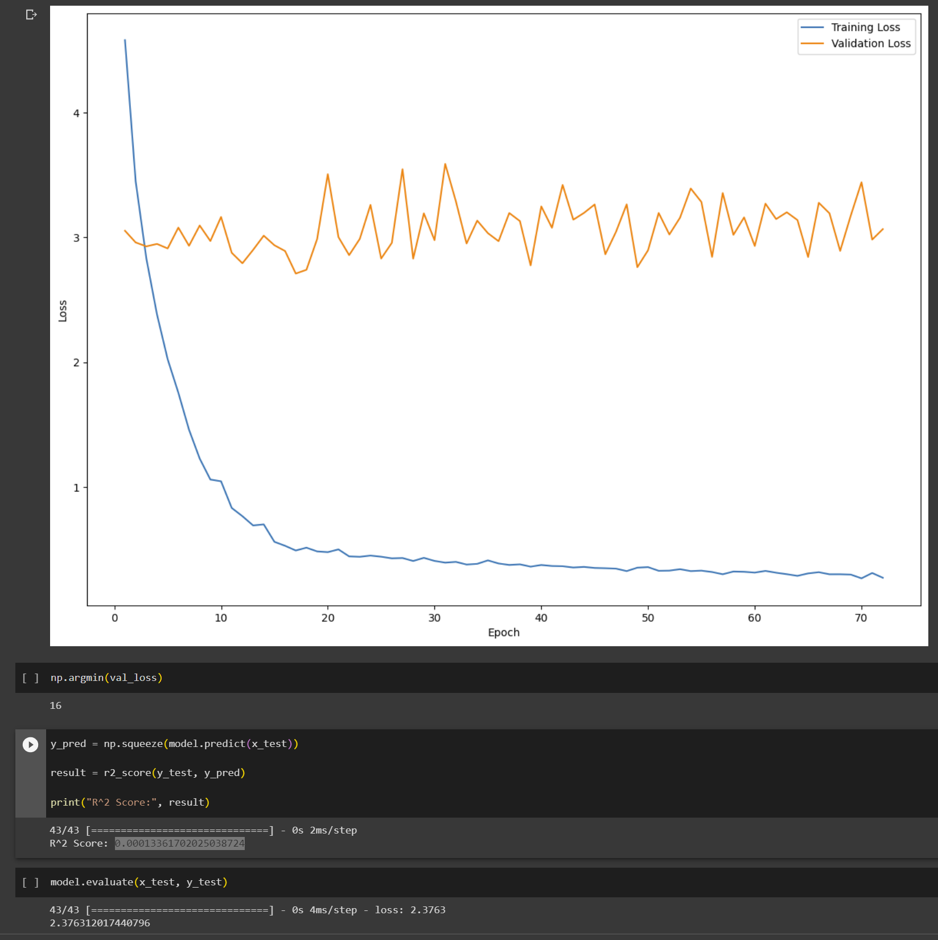


Final Thoughts on Sales Prediction Model
The sales prediction model had a low R^2 score (0.00013361702025038724)
This is likely due to the fact that the column data was based on game name, year released, genre, publisher, rating, global sales, critic score, critic count, user score, and user count.
None of this data seems to correlate to each other.
We believe in the future, collecting additional data, such as number of copies sold or price per copy, we would see a stronger correlation.

Slide 13
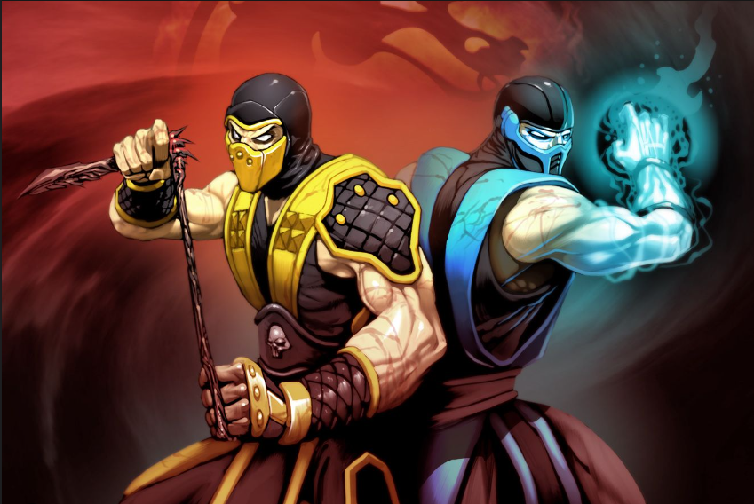
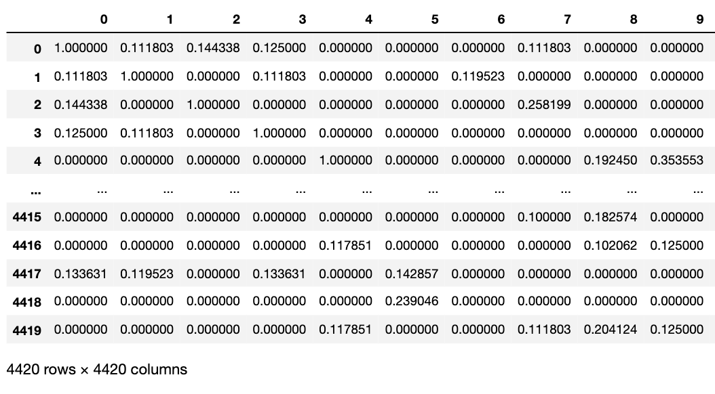
Similarity Search Accuracy
Snapshot of code and similarity scores from a search

Slide 14
THANKS!
Questions?
Alvaro, Dozie, Emmanuel, Erick, Jonathan, & Mickey

Slide 15
Who wants to volunteer?!
?
Question for the class:
Give us a query to run in our recommendation tool!

